Slide 1
Keeping Up With State Licensure
Anita Skarbek, PhD, RN
UMKC School of Nursing and Health Studies
January 8, 2018

Slide 2

Objectives
Brief Background Overview – State Board of Nursing Regulations
Initial Procedure
Revised Procedure
Process Undertaken
Disclosures
Q&A Period

Slide 3
Background
2013 Nurse License Review Group Formed
    RN-BSN Program Director
    Assistant Dean for Program Evaluation
    Director of Student Services
Member Selection Benefit
    Members of UMKC’s eLearning Action Committee (e-LAC)
      State Authorization Mandates
      RN-BSN Program Director – Online Faculty
      Student Services Director
        Oversees Academic Advisors
        Internal Policy & Procedures

Slide 4
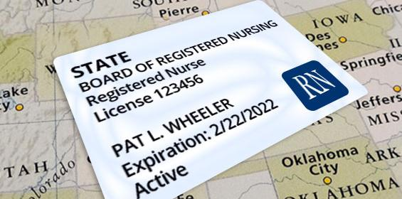
Initial Procedure
3 Members License Review Group (Pre-SARA)
  Reviewed State Boards of Nursing Requirements
    SHEEO State Authorization Survey Results & Reports
    Seek Approvals - Every BON & State Dept. of Education
    Group Met
      Determine where programs can be delivered.
      Referred legal questions to Assoc. Dean
    Provided Hard-Copied List to Brandie Elliott, UMKC State Authorization Coordinator

Slide 5
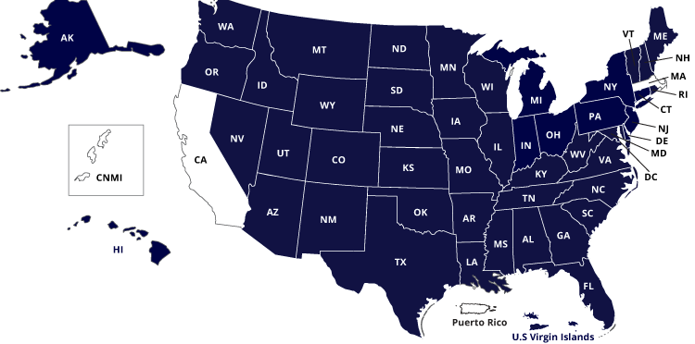
Revised Procedure
SARA States & Institutions

Slide 6
Revised Procedure
1 person from SoNHS (Anita Skarbek) Reports to Brandie Elliott
  Maintains each state’s BON requirements list
  Reports changes to Brandie Elliott, SoNHS Online Program Directors, Program Coordinators, Academic Advisors, Administrators
  Attends Monthly SAN Coordinator Calls
  State Regulator/BON Updates
    Conferences
      NASASPS/WCET Annual Conference
      AACN BSN Annual Conference
    WCET Listserv
      Russell Poulin

Slide 7
Process
Contact each state BON
  Attempt to obtain information in writing
  Phone call – record date, contact name
SoNHS Assoc. Dean – JD
  Questions/Clarification
SoNHS Student Database
Outlook e-Mail SAN Folder
  UM System Archived Server
Brandie Elliott
  Confluence Software Sharing Platform https://www.atlassian.com/software/confluence/features
  Updates UMKC State Authorization Map
Notify SoNHS Program Directors/Coordinators, Student Services Director, Academic Advisors, Administrators
  e-Mail, Committees (Executive Council & Steering Committee)
Disseminate Info to Faculty
  Program Directors & Faculty Assembly

Slide 8
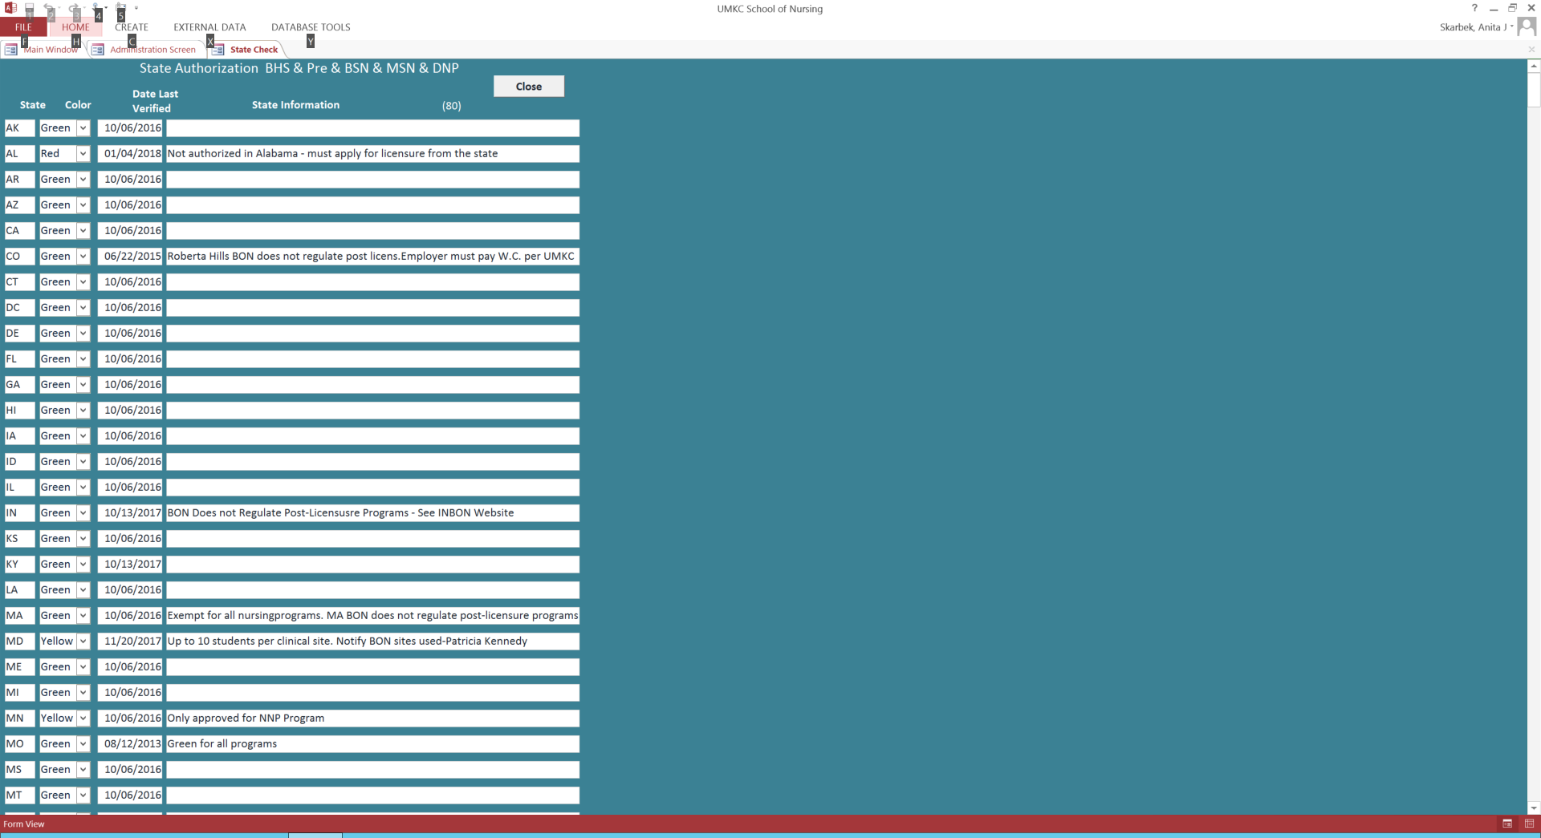
Student Database

Slide 9
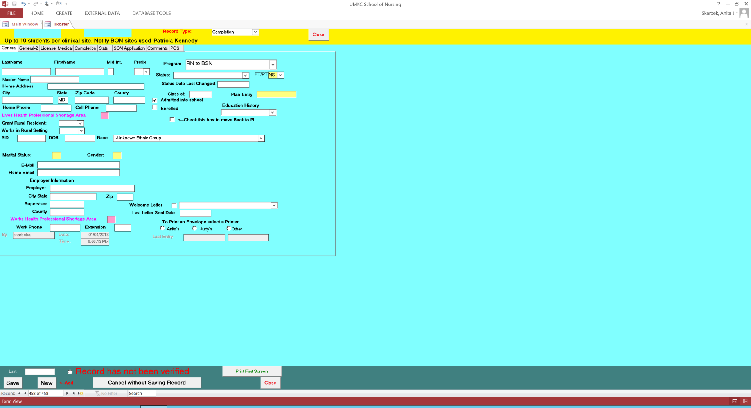
Student Database
Academic Advisors’ Screen

Slide 10
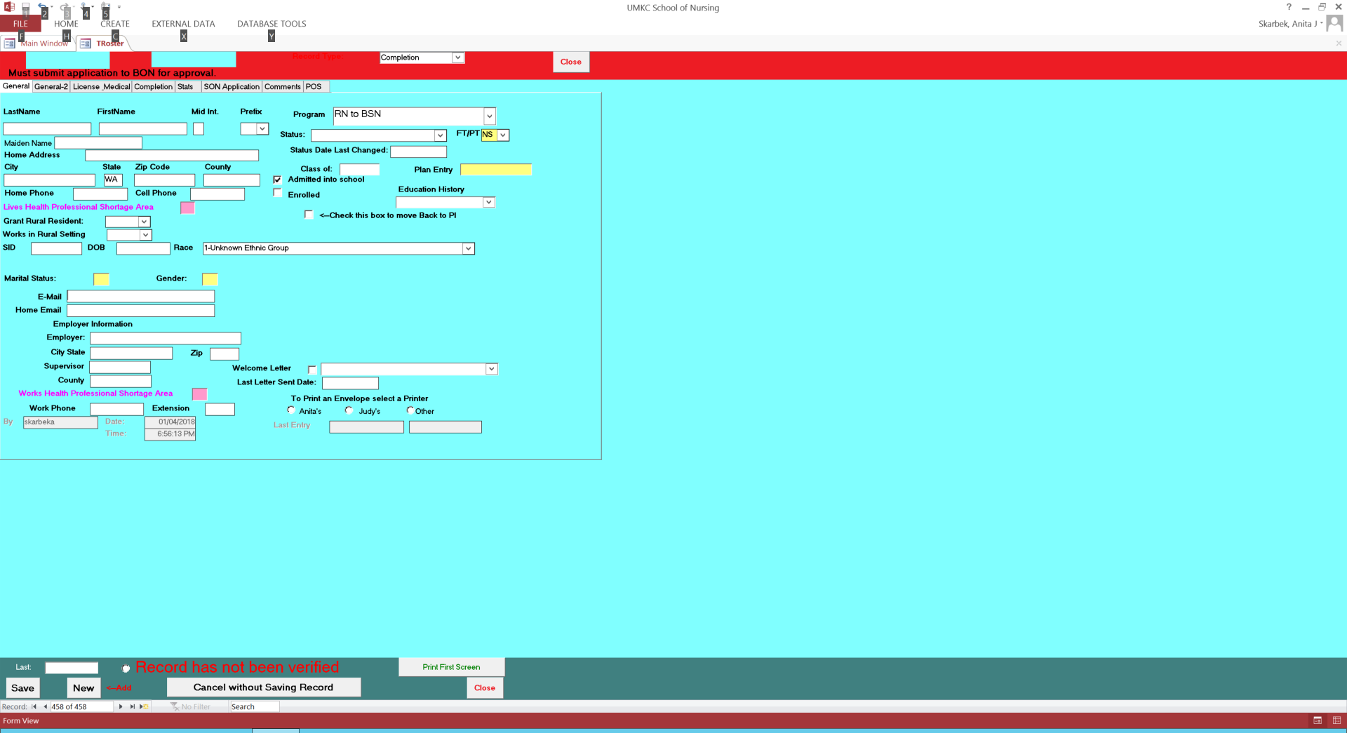
Student Database
Academic Advisors’ Screen

Slide 11
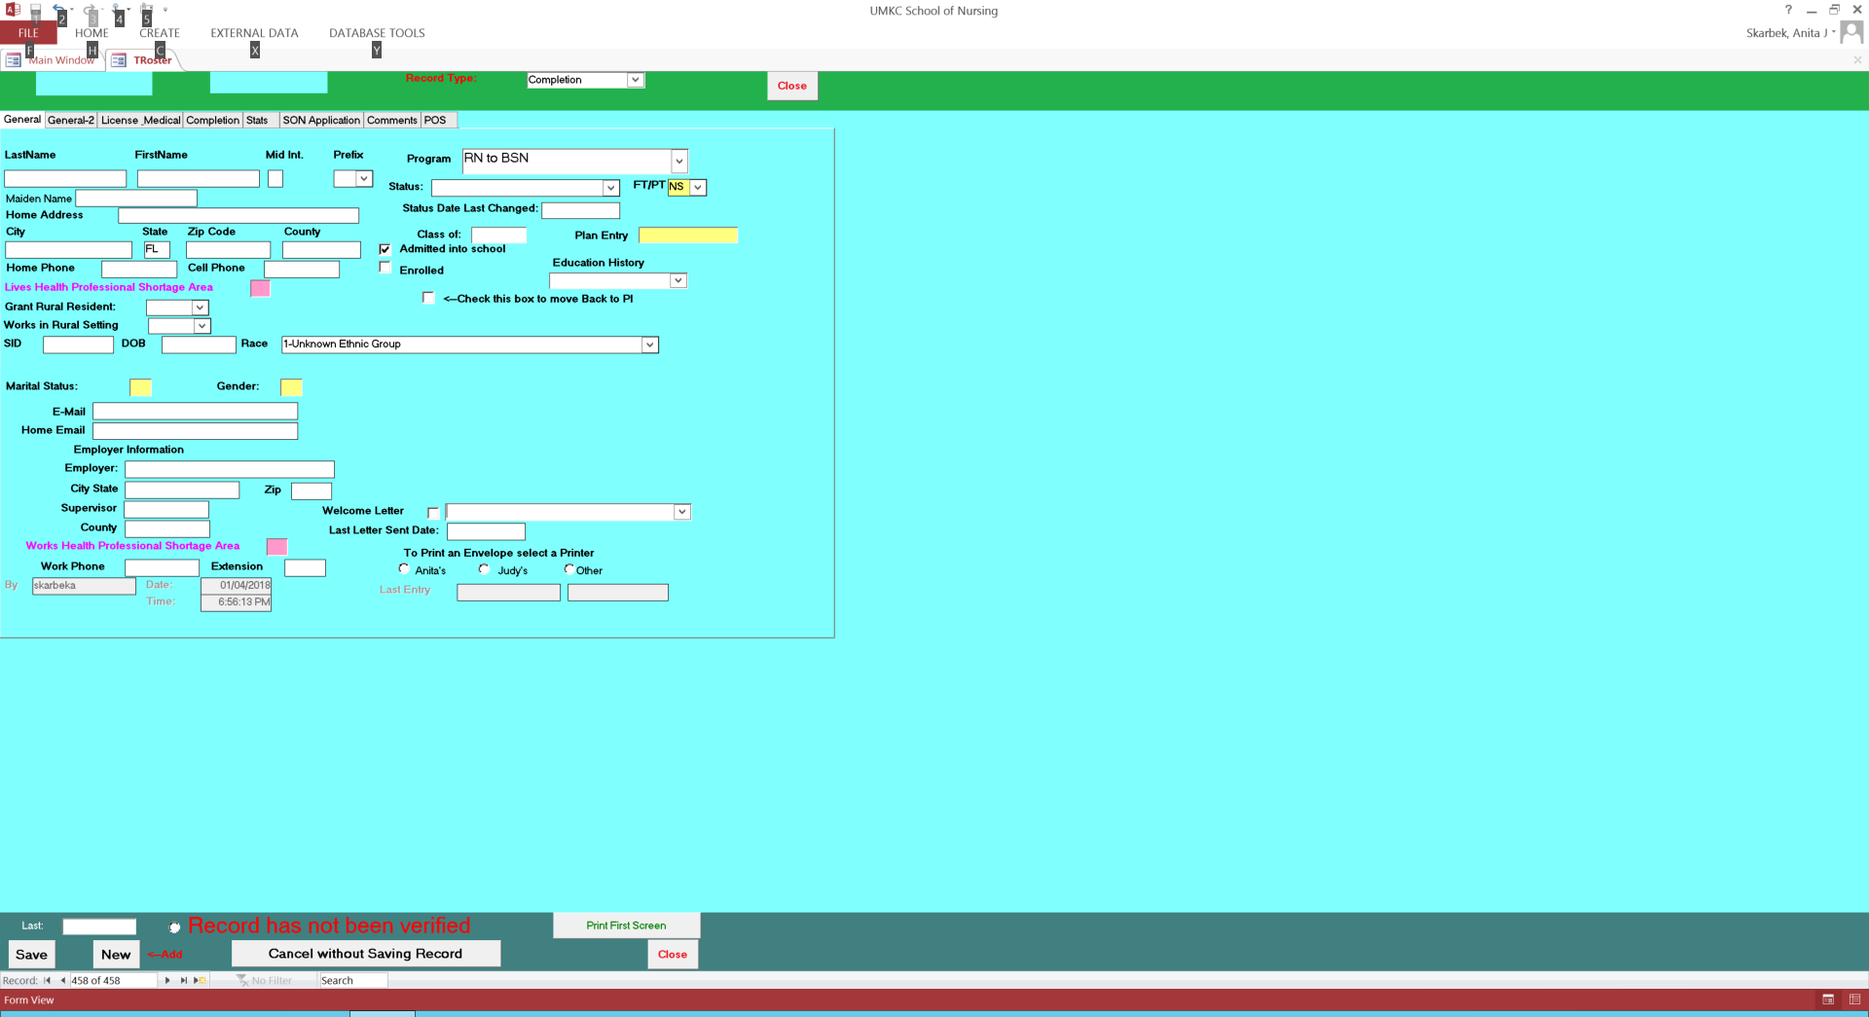
Student Database
Academic Advisors’ Screen

Slide 12
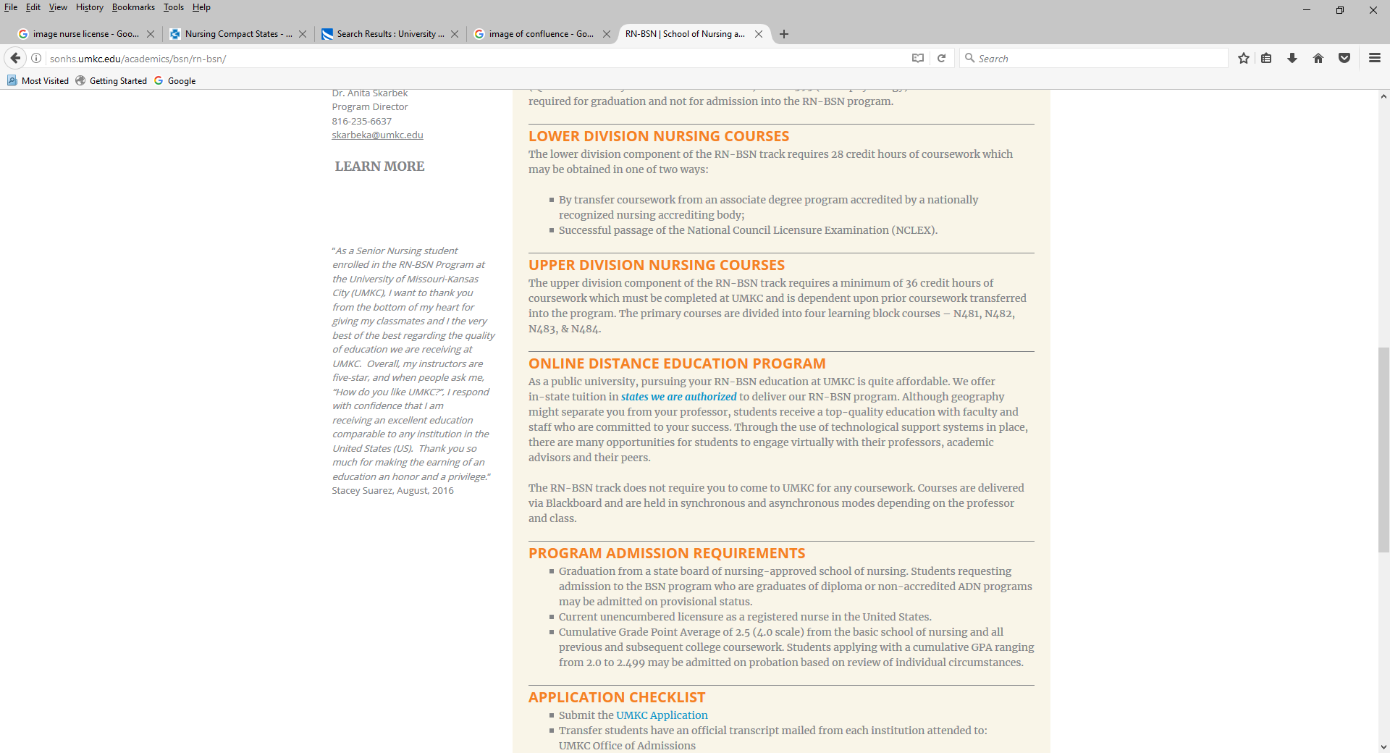
SoNHS Disclosures
RN-BSN Program

Slide 13
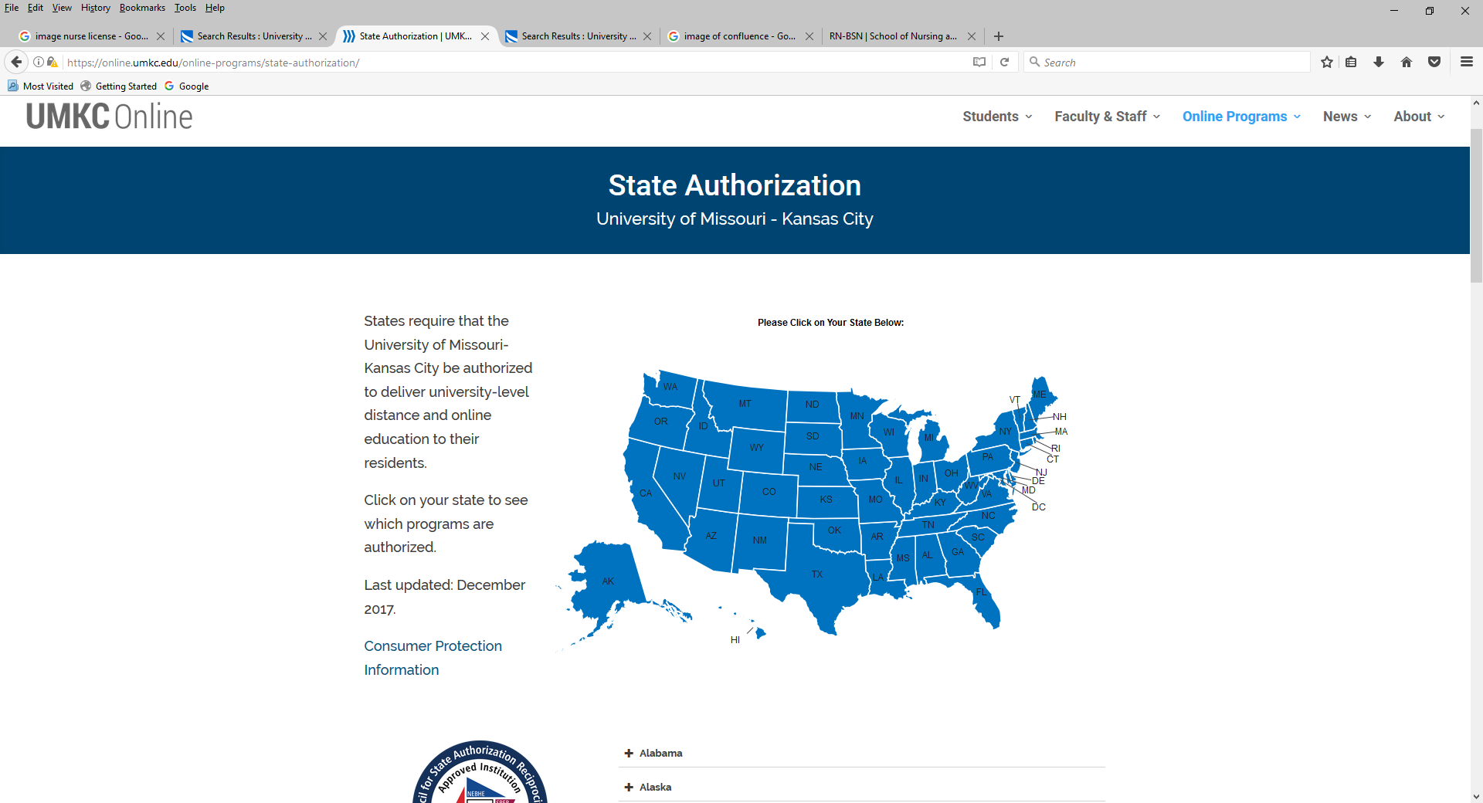
SoNHS Disclosures
RN-BSN Program

Slide 14
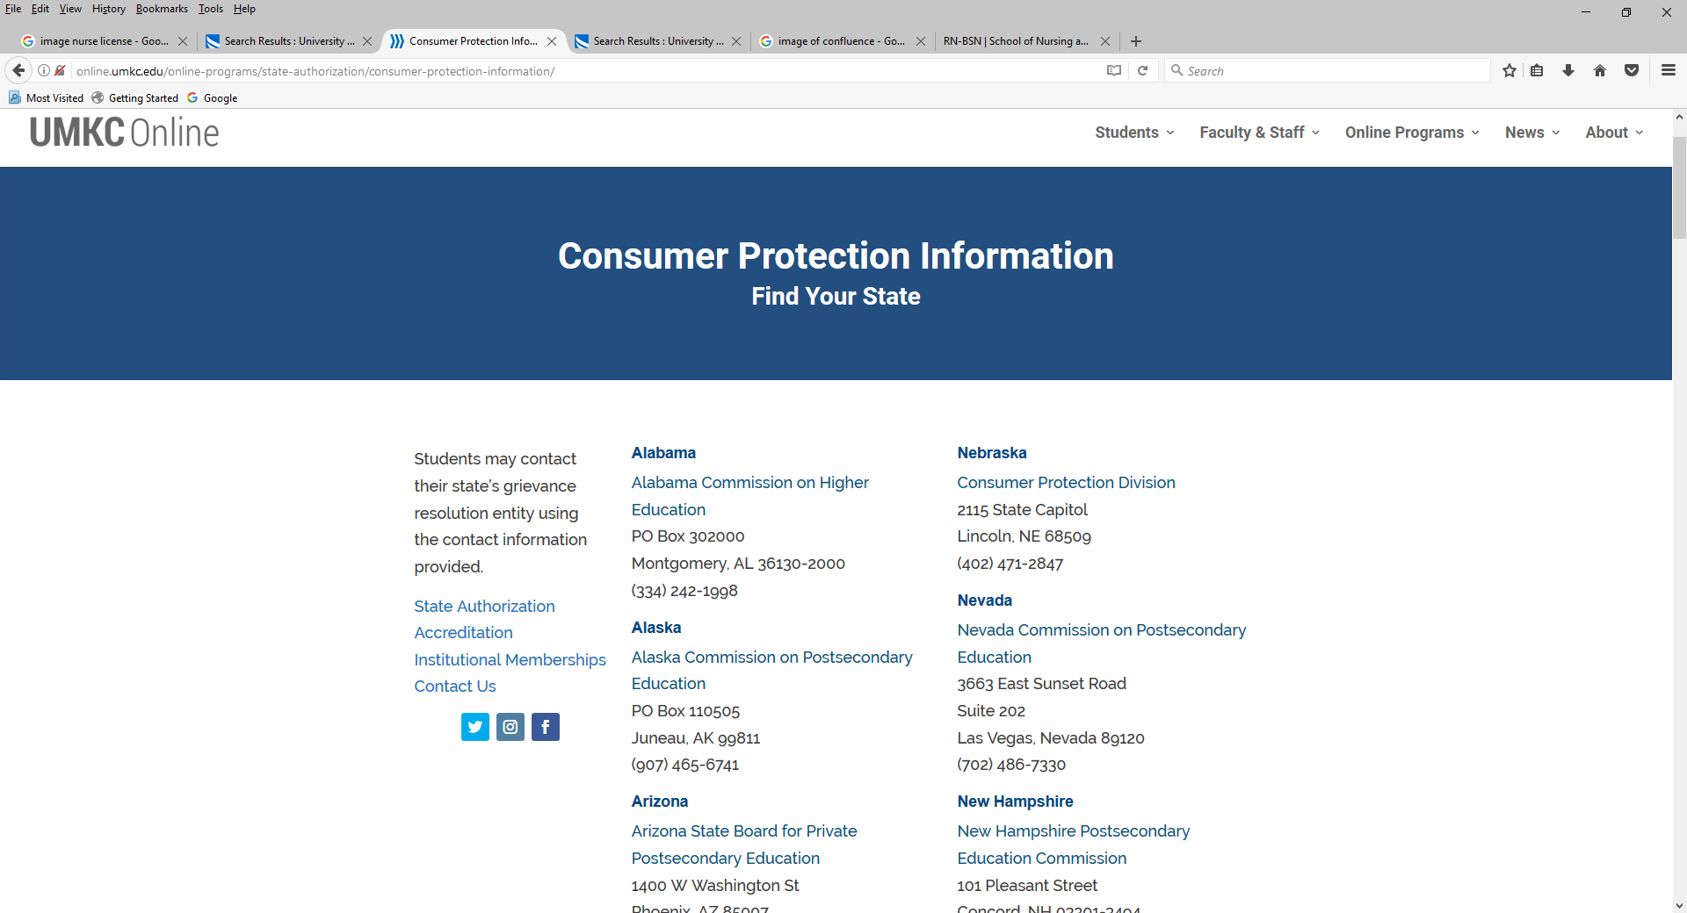
SoNHS Disclosures
RN-BSN Program

Slide 15
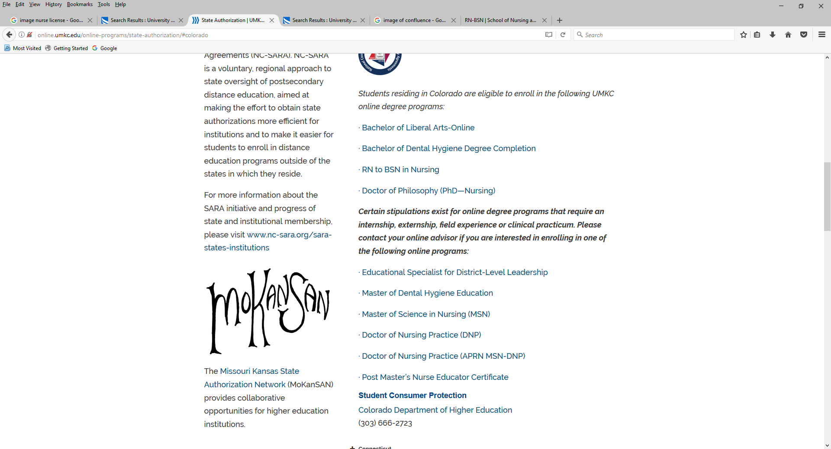
SoNHS Disclosures
RN-BSN Program

Slide 16
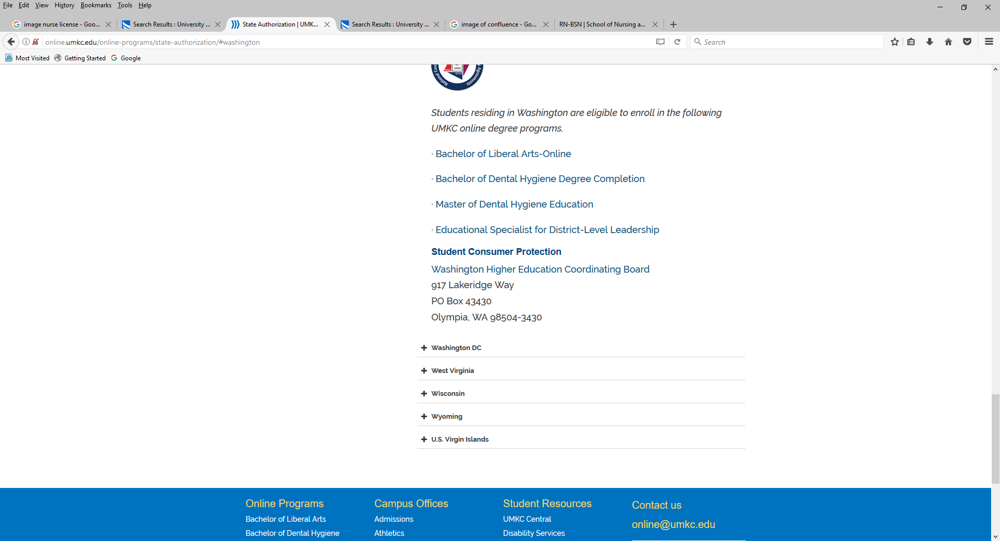
SoNHS Disclosures
RN-BSN Program

Slide 17
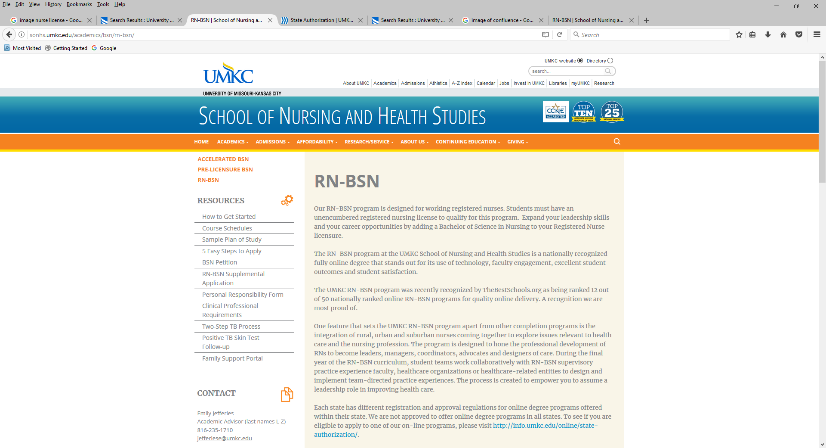
SoNHS Disclosures
RN-BSN Program

Slide 18
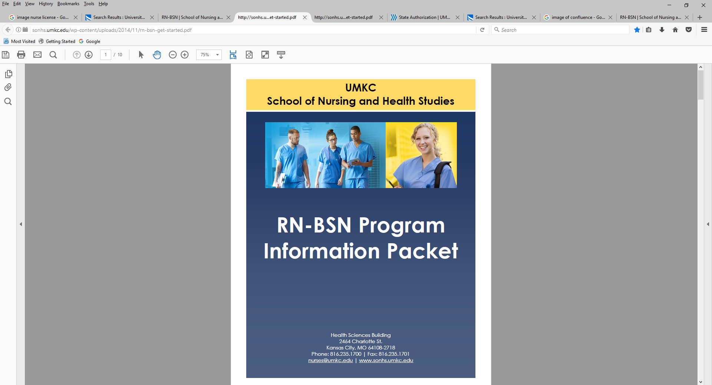
SoNHS Disclosures
RN-BSN Program

Slide 19
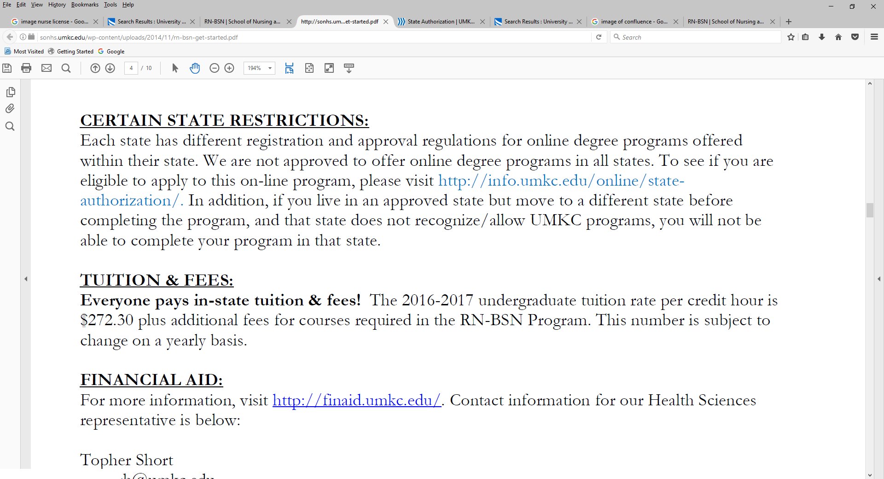
SoNHS Disclosures
RN-BSN Program

Slide 20
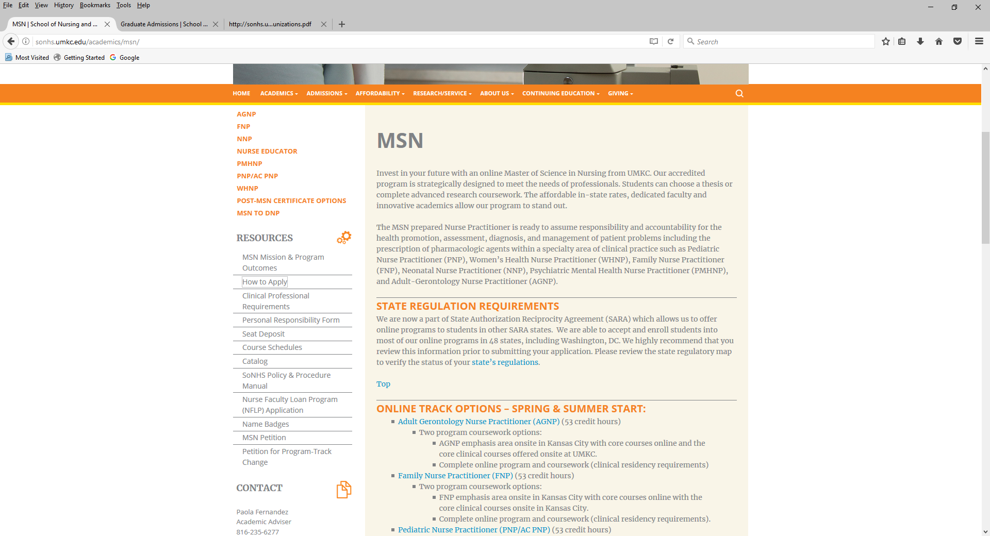
SoNHS Disclosures
MSN Programs

Slide 21
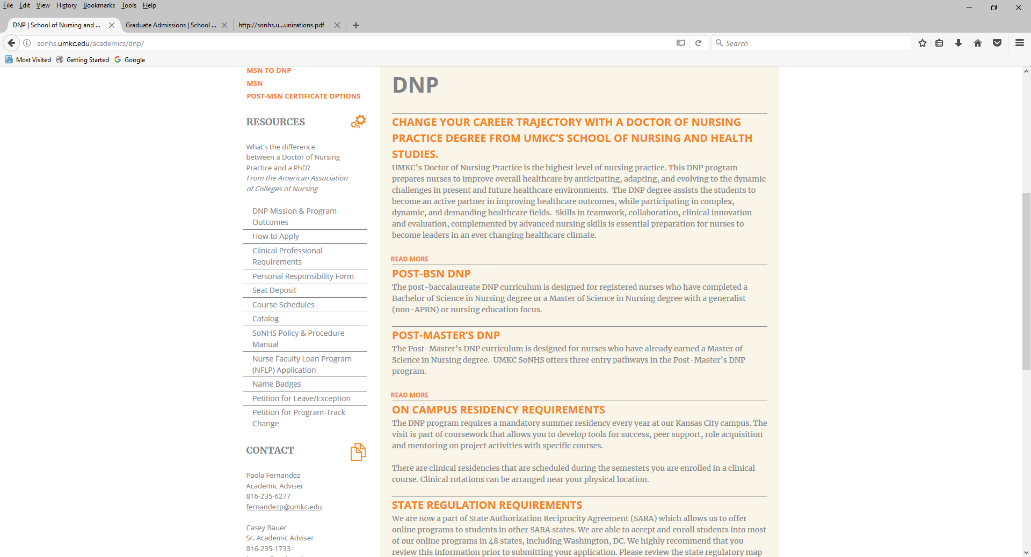
SoNHS Disclsures
DNP Programs

Slide 22
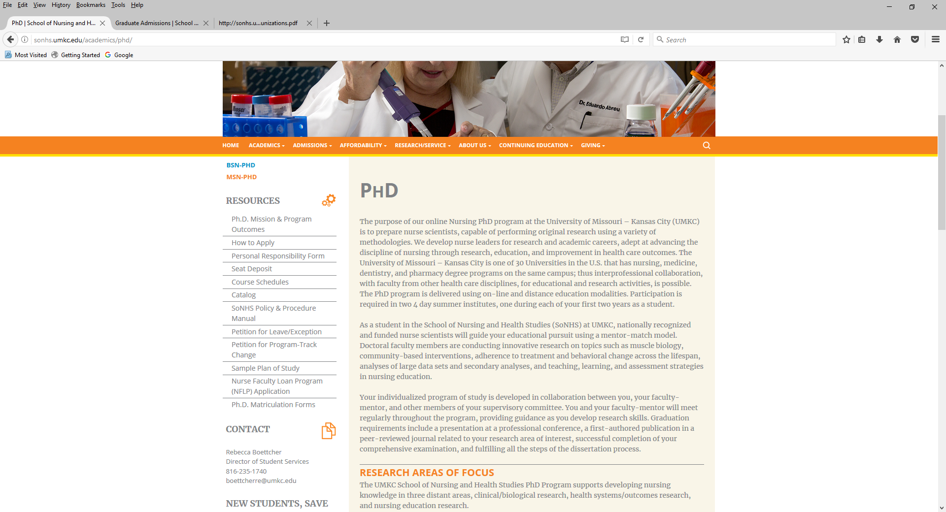
SoNHS Disclosures
PhD Program

Slide 23
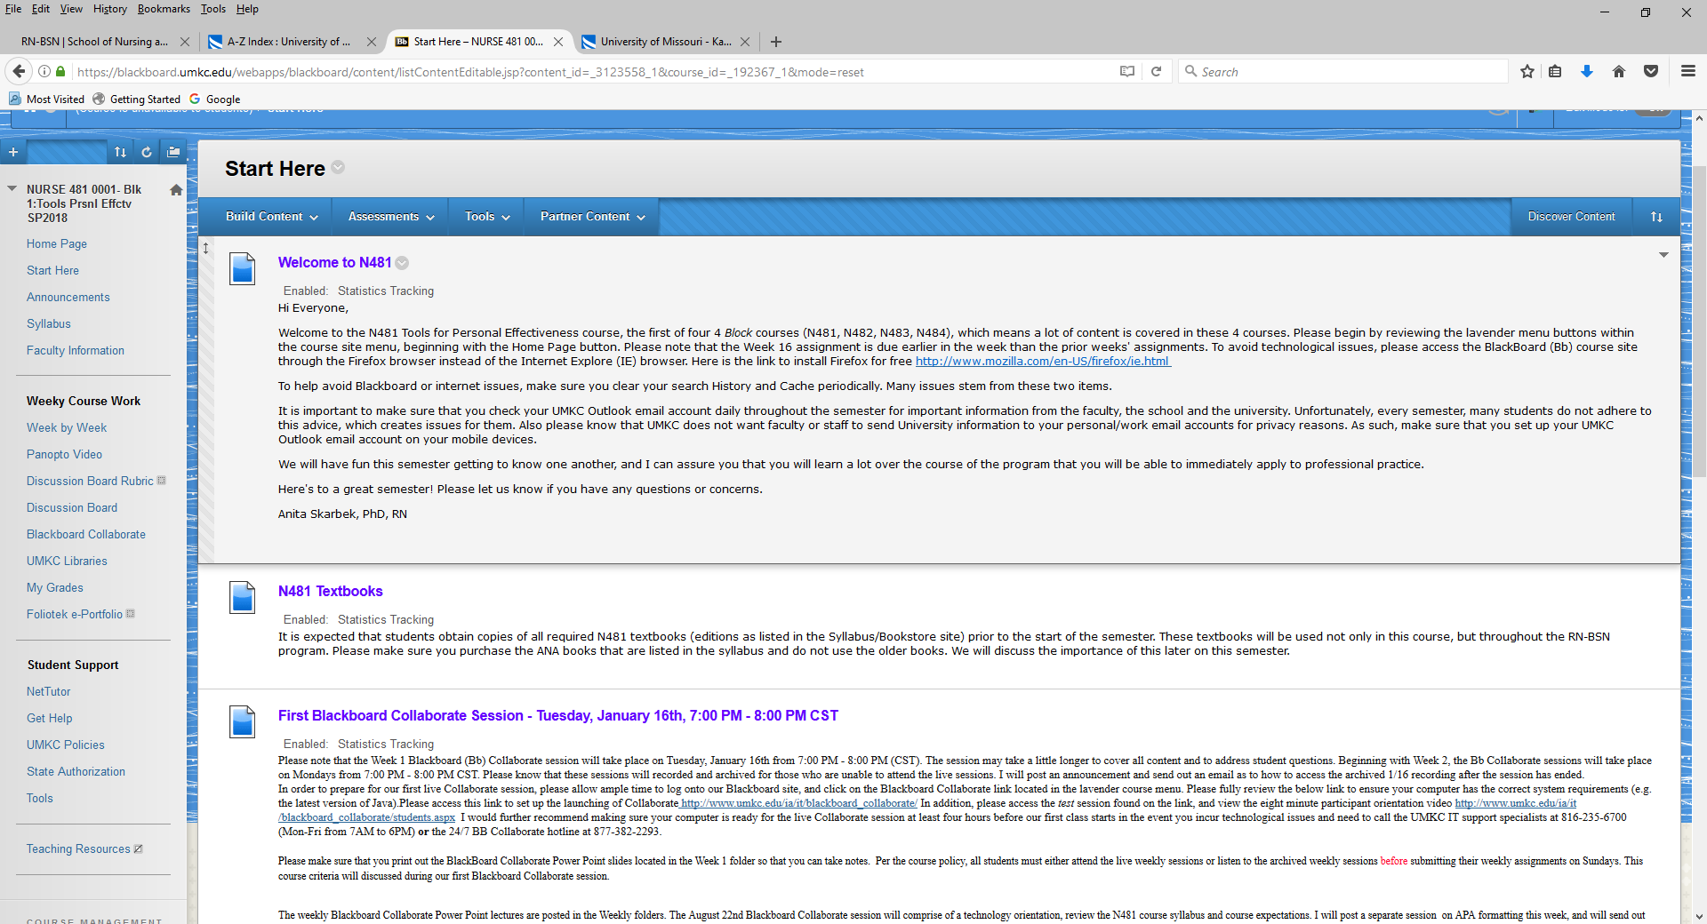
UMKC Disclosures
Blackboard Course Sites

Slide 24
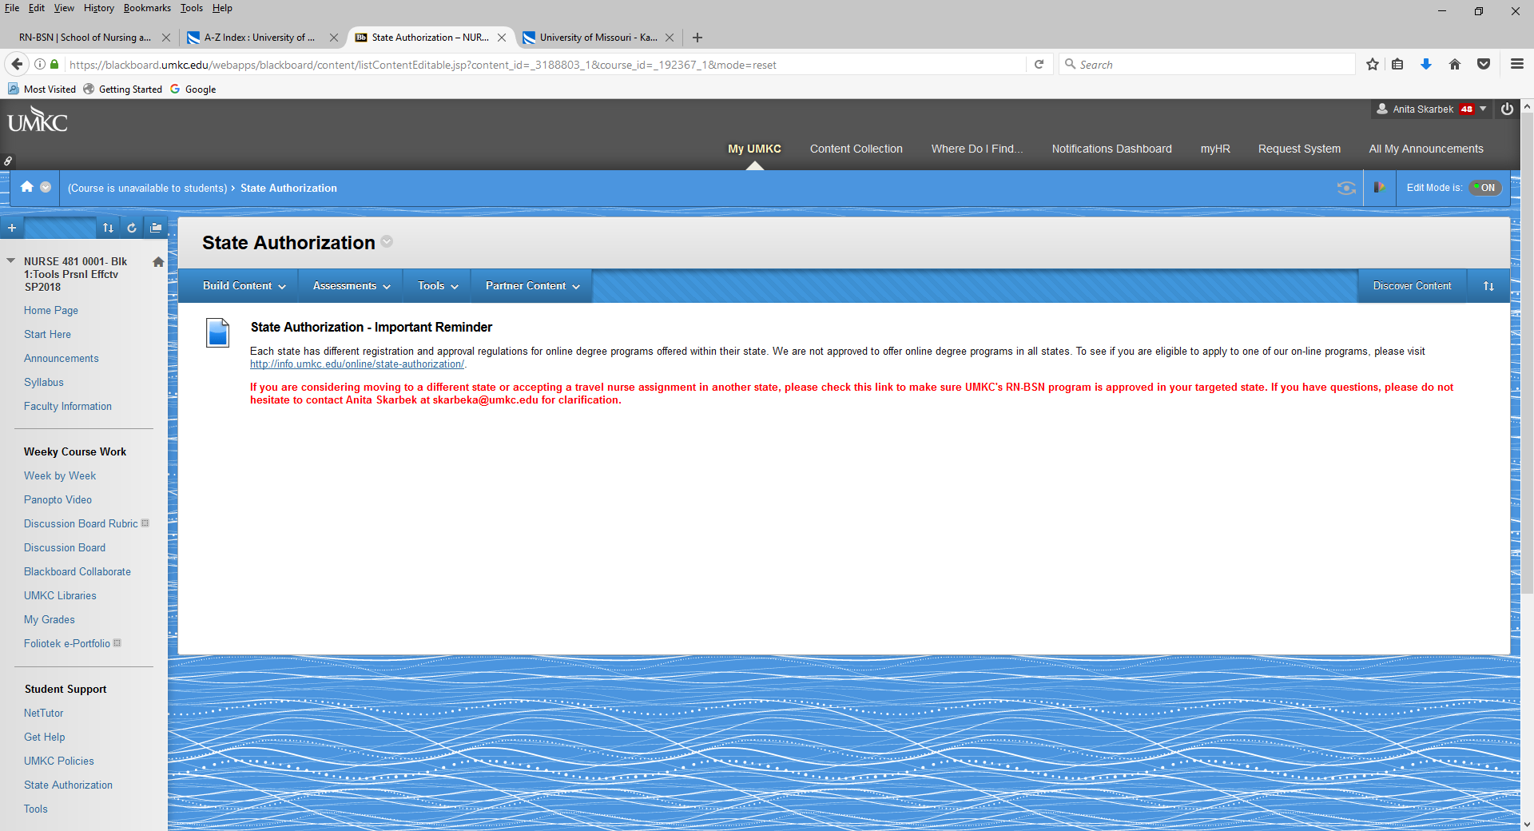
UMKC Disclosures
Blackboard Course Site

Slide 25
Closing Comments
Identify Individual(s) Responsible to Monitor BON requirements
  Create a communication system to disseminate information to academic advisors, program directors and coordinators, school administrators
Tracking System
  States where prospective students/current students reside
  How will system be monitored?
    Avoid having students admitted in states where not authorized.
Maintain Updated BON Information
  Obtain written confirmation, when possible
    BON websites
    BON contact person
  How often will information be updated?
  Do not rely on information other schools/entities provide
    Seek out the information
      Each school’s program may be different in some manner

Slide 26
Closing Comments
Provide Student Reminders Regarding Moving & Travel Nurse Assignments
  Every semester
  Learning Management System (e.g. Blackboard course sites)
  Course Syllabus
  1st Lecture
Do Not Panic
  Notify appropriate individuals (your institution)
  Notify BON to discuss issue & seek resolution
  Document information
    Example: Washington State RN-BSN Student
Keep Informed
  WCET SAN Coordinator Calls
  Conferences
  Listservs

Slide 27


