Slide 1
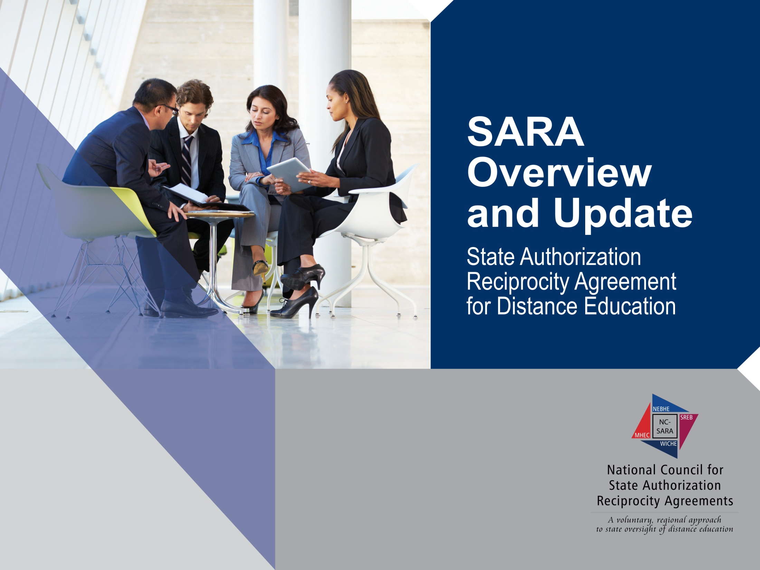
MoKanSAN Summit
Kansas City, Missouri
January 8, 2018

Slide 2


Presenter:
Marshall A. Hill
Executive Director, NC-SARA

Slide 3

Goals
SARA establishes a state-level reciprocity process that will support the nation in efforts to increase the educational attainment of its people by making state authorization:
  more efficient, effective, and uniform in regard to necessary and reasonable standards of practice that could span states;
  more effective in dealing with quality and integrity issues that have arisen in some online/distance education offerings; and
  less costly for states and institutions and, thereby, the students they serve.

Slide 4

SARA: A negotiated compromise
Institutions’ goals
Regulators’ concerns
Others
Accreditors
Regional compacts
National commission

Slide 5
The Evolution of SARA
Lumina Foundation provided funding to the Presidents’ Forum, working with the Council of State Governments (CSG), to develop a Model State Authorization Reciprocity Agreement (SARA) that states could adopt to acknowledge other states’ work and decisions in regard to institutional authorization.
Building upon the work of the Presidents’ Forum and CSG, the Western Interstate Commission for Higher Education (WICHE) advanced “W-SARA” in collaboration with the regional higher education compacts (SREB, MHEC, NEBHE).
Combining all prior efforts and input from all stakeholders, the Commission on the Regulation of Postsecondary Distance Education, founded by SHEEO and APLU, and chaired by former Secretary of Education Richard W. Riley, issued its report: “Advancing Access through Regulatory Reform: Findings, Principles, and Recommendations for the State Authorization Reciprocity Agreement (SARA).”
Funding for national and regional implementation provided by Lumina Foundation.

Slide 6

The SARA solution
A nation-wide system of reciprocity administered by the four existing regional compacts
MHEC
NEBHE
WICHE
SREB

Slide 7

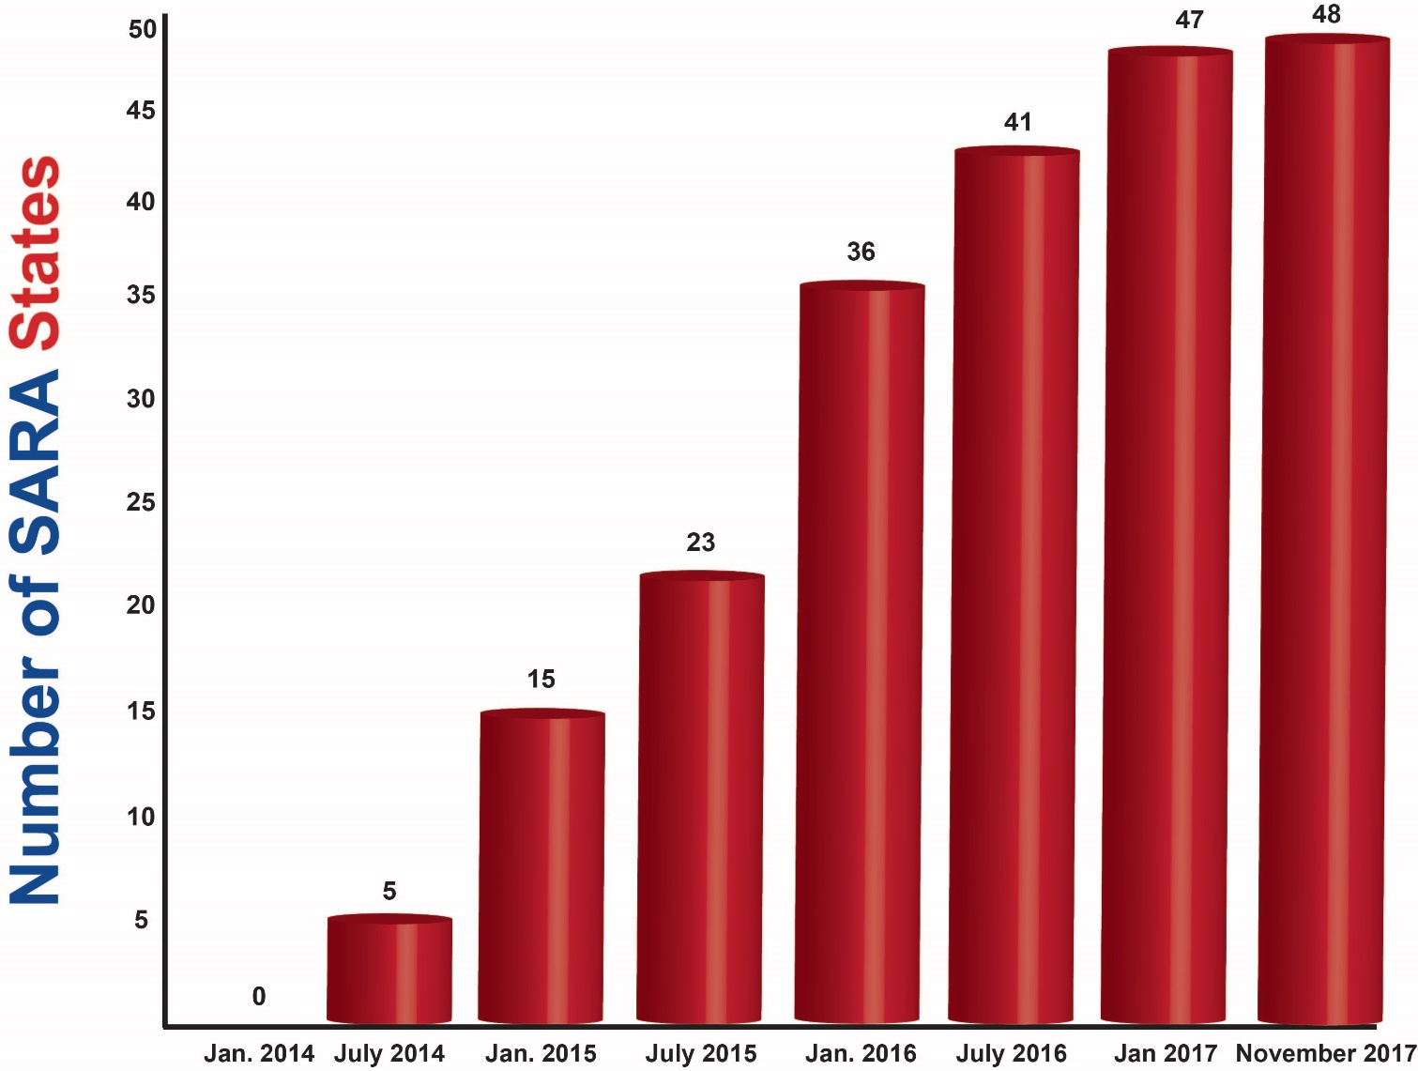
SARA Member States

Slide 8

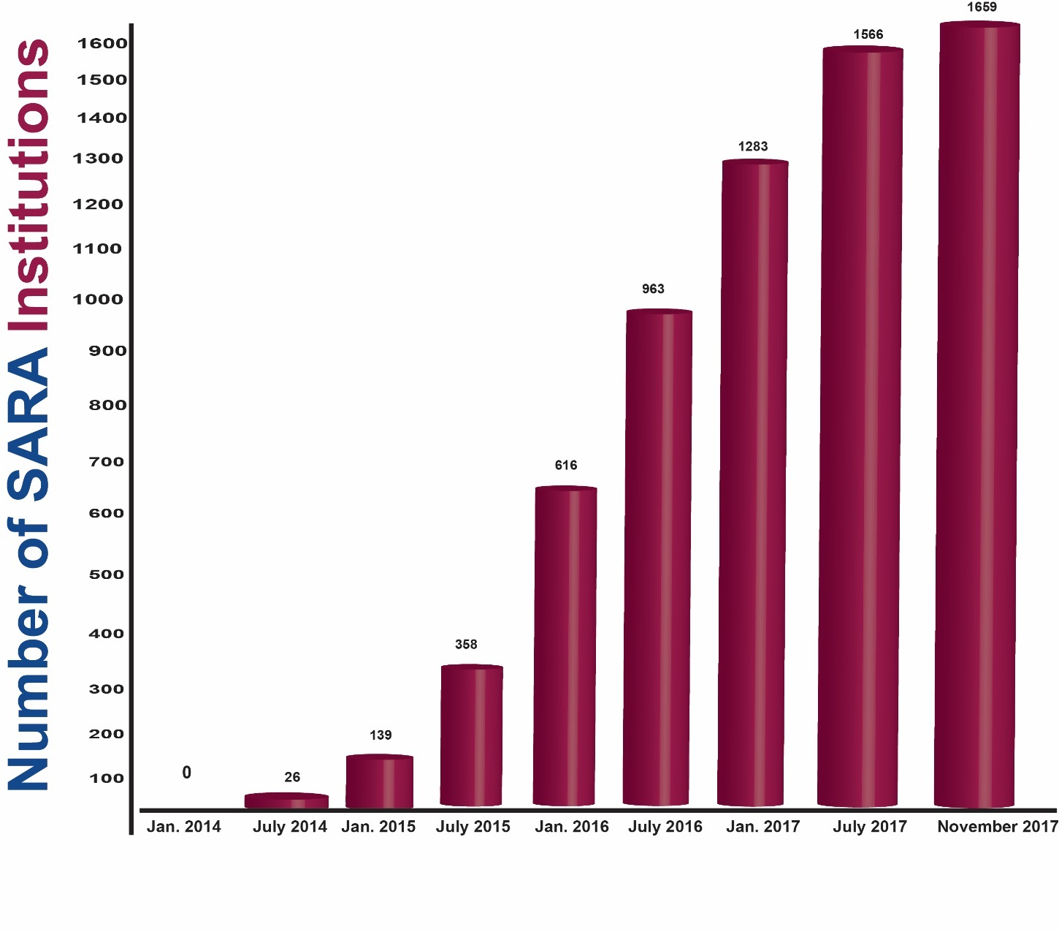
SARA-participating Institutions

Slide 9
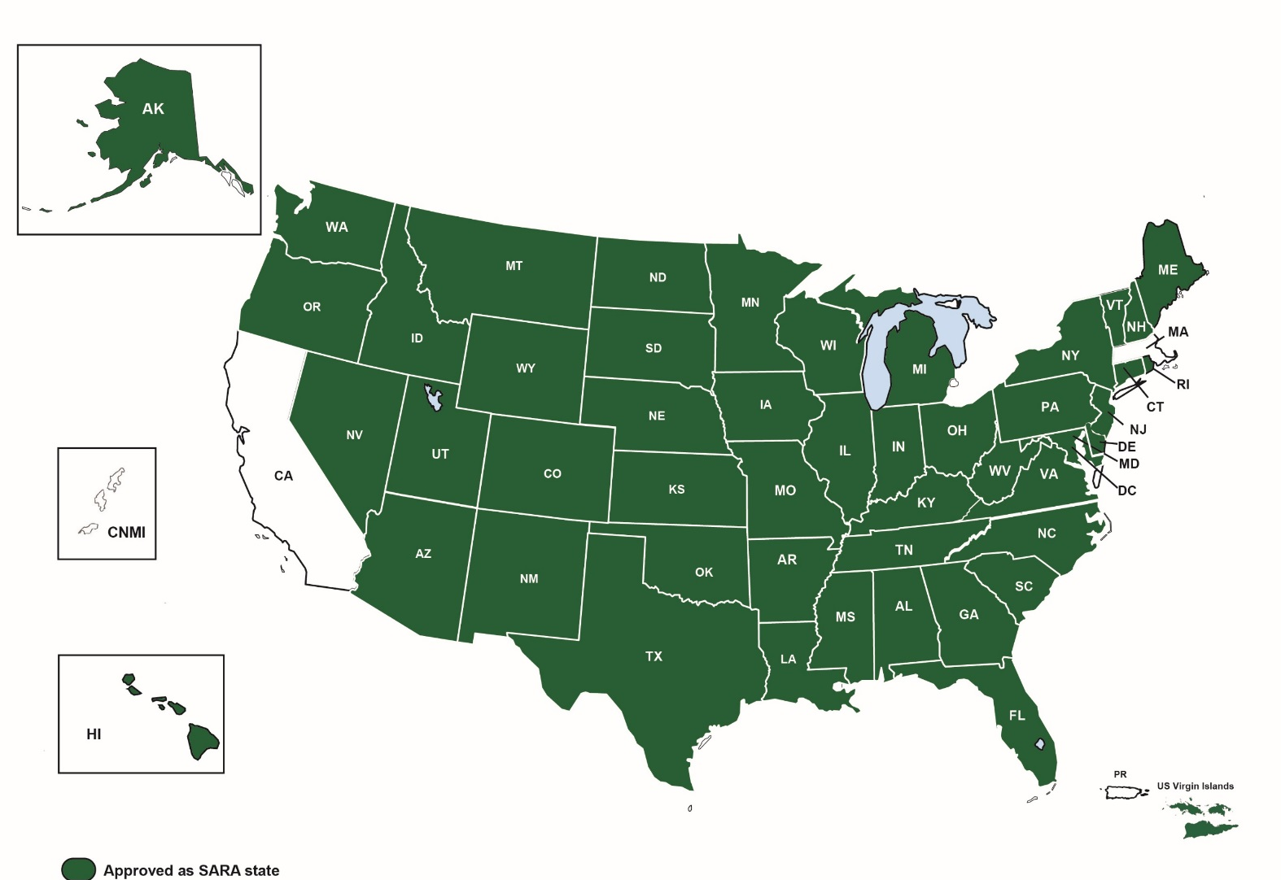
The Current SARA Landscape
As of November 27, 2017

Slide 10

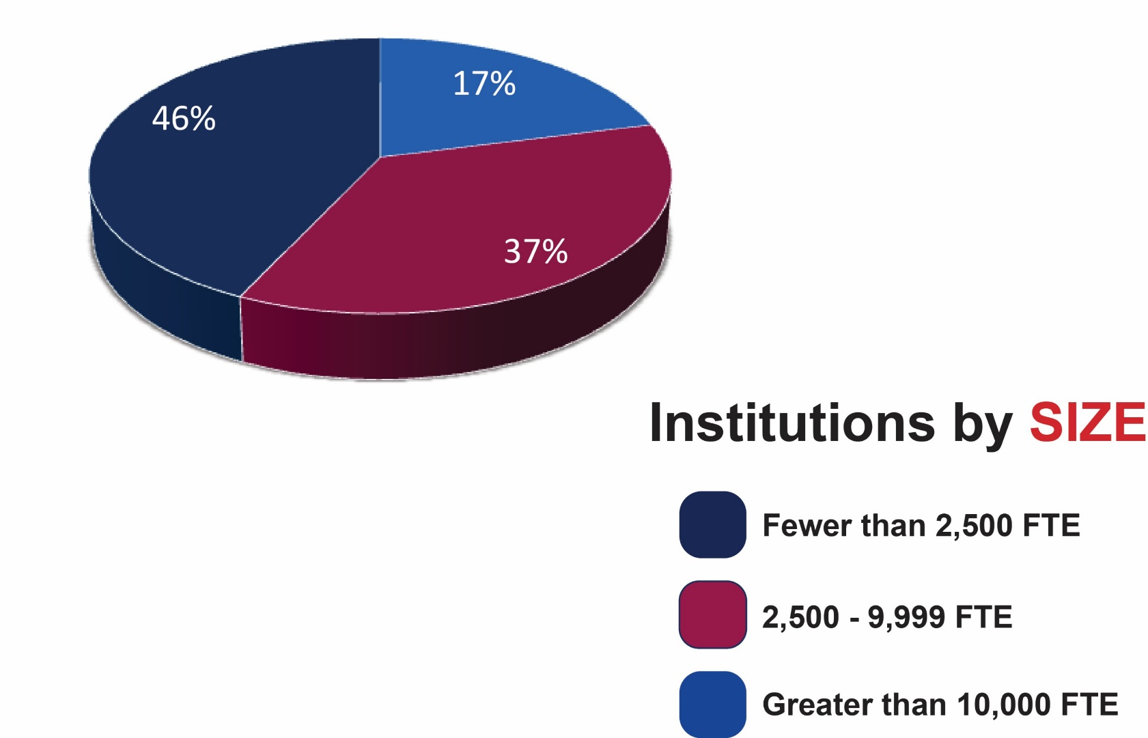
Institutions by Size
As of November 27, 2017

Slide 11
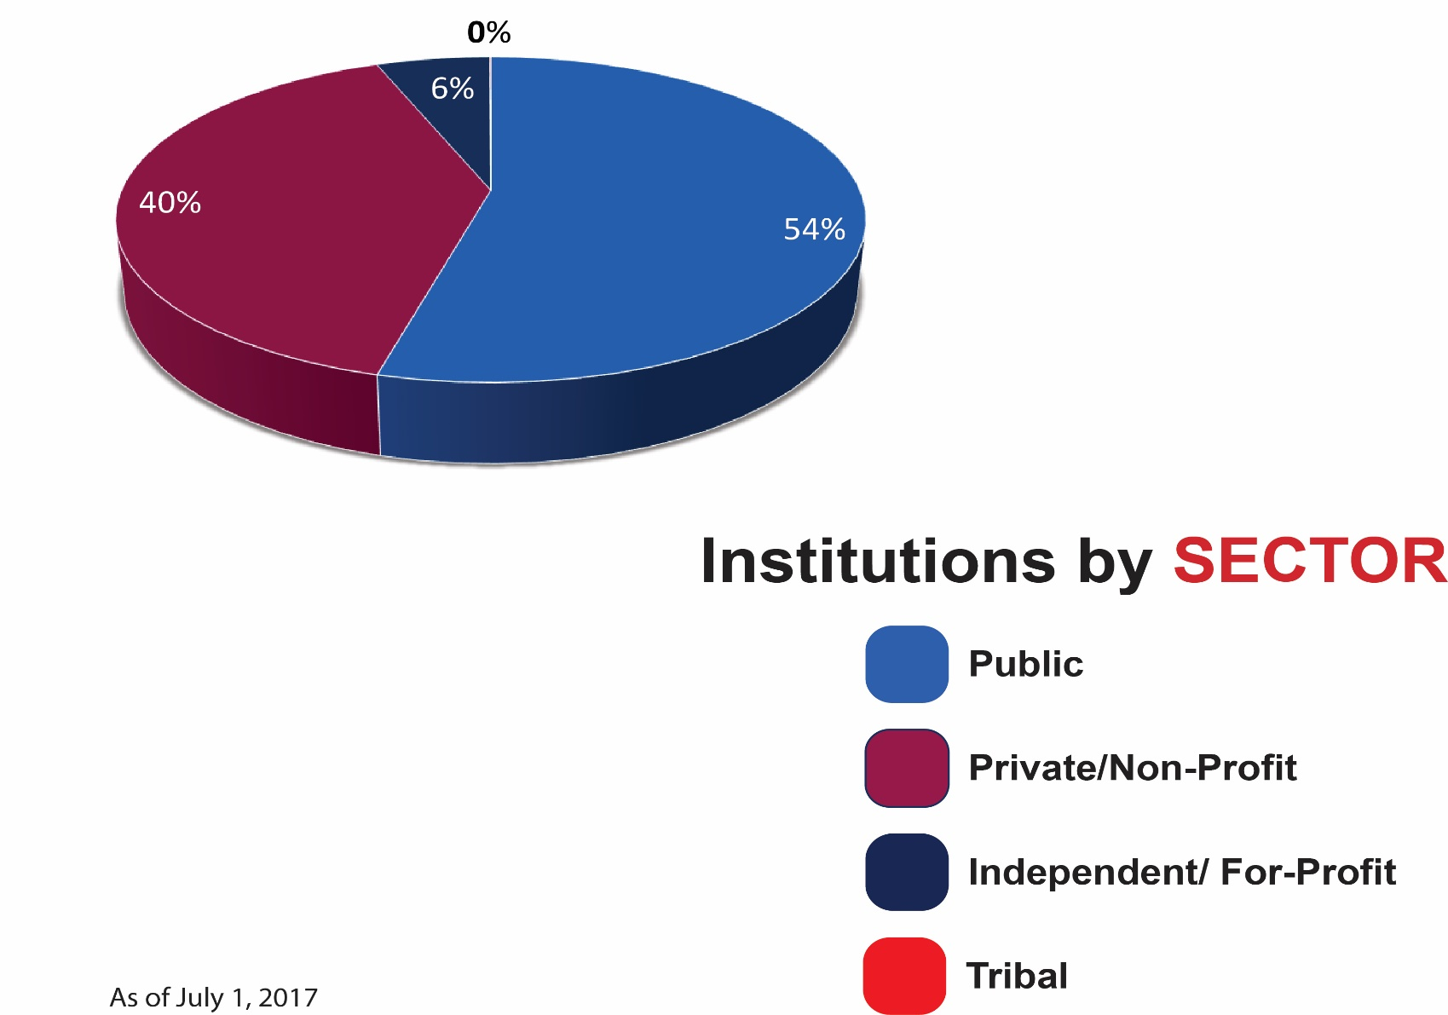
Institutions by Sector
As of November 27, 2017

Slide 12
2017 Enrollment Report
1,477 institutions reported
1,170,725 total reported enrollments
Report is available on the
NC-SARA web page:
www.nc-sara.org

Slide 13
Essential principles of SARA (1)
Voluntary for states and institutions.
Acknowledges the traditional roles within higher education’s “accountability triad”: federal government, states, and accrediting bodies recognized by the U.S. Department of Education.

Slide 14
Essential principles of SARA (2)
Lays out a framework for state-level reciprocity, including a governance structure, implementation by the four regional higher education compacts (MHEC, NEBHE, SREB, WICHE), a
National Council for SARA to ensure comprehensive national coverage, and
a financial plan to support operations.

Slide 15
Essential principles of SARA (3)
Requires states to approve their
in-state institutions for SARA participation (based upon institutional accreditation and financial stability) and resolve student complaints.
SARA states agree to impose no additional (non-SARA) fees or requirements on institutions from other SARA states.

Slide 16
Essential principles of SARA (4)
Open to degree-granting postsecondary institutions from all sectors: public colleges and universities; independent institutions, both non-profit and for-profit.
Sets forth a reasonable, uniform set of triggers of “physical presence”.
Preserves state approval and oversight of on-the-ground campuses.

Slide 17
Essential principles of SARA (5)
Shifts principal oversight responsibilities from the state in which the distance education is being received to the “home state” of the institution offering the instruction. (Host state can also work to resolve problems.)
Initial funding from Lumina Foundation, eventual reliance on institutional fees paid to the National Council for SARA.

Slide 18
Experiential learning placements
Why deal with experiential education at all?
Beneficial for students
Many states regulate it
Required for some degree programs (allied health, teaching, etc.)
Programs intended to lead to licensure

Slide 19
Benefits to students
Expands access to educational offerings.
Better resolution of complaints from students in SARA states.
Reduces a rapidly growing institutional cost that is in one way or another passed along to students.
Enhances overall quality of distance education.

Slide 20
Experiential learning basics for licensed professions
Check with the state’s licensing entity
Meet their requirements
SARA basic provisions
  Ten students/program/site
See SARA Manual, especially Sections 5.2 and 5.13

Slide 21
SARA News
Summary of 11/3/2017 NC-SARA meeting available at www.nc-sara.org (see blog post)
Current NC-SARA fees will continue through June 30, 2020
Presentation slides on 2017 enrollment reporting
Draft Minutes of the meeting are on the NC-SARA website

Slide 22
SARA News . . . continued
Mary Larson is now NC-SARA’s Associate Director for Student and Institution Support
  New edition of SARA Manual (January 2018)
  Additional online resources (spring 2018)
  Redesign of website (spring 2018)
  Former SHEEO “State Surveys” (spring 2018)
  Revised process forms (January 2018)

Slide 23
SARA News . . . continued
Reporting of Experiential Learning Placements (spring 2018)
  Voluntary for 2018, required in 2019
  ELP Reporting Guide coming February, 2018
July 2018 federal rules
HEA reauthorization

Slide 24
Benefits to institutions
Enables more efficient provision of distance education to a broader market.
Reduces number of applications to other states.
Reduces number of other-state regulations to monitor for changes.
Reduces costs.
  Reduced costs = potentially lower fees for students.

Slide 25
Benefits to states
Expands educational offerings to residents.
Allows SARA states to focus on their home-state institutions.
Maintains state regulation of on-the-ground instruction offered by out-of-state institutions.
Other SARA states will help resolve complaints.
Reduces costs for institutions.
No fees charged to states to participate in SARA.

Slide 26

SARA Resources
NC-SARA Website, www.nc-sara.org
Marshall Hill, mhill@nc-sara.org

